Slide 1
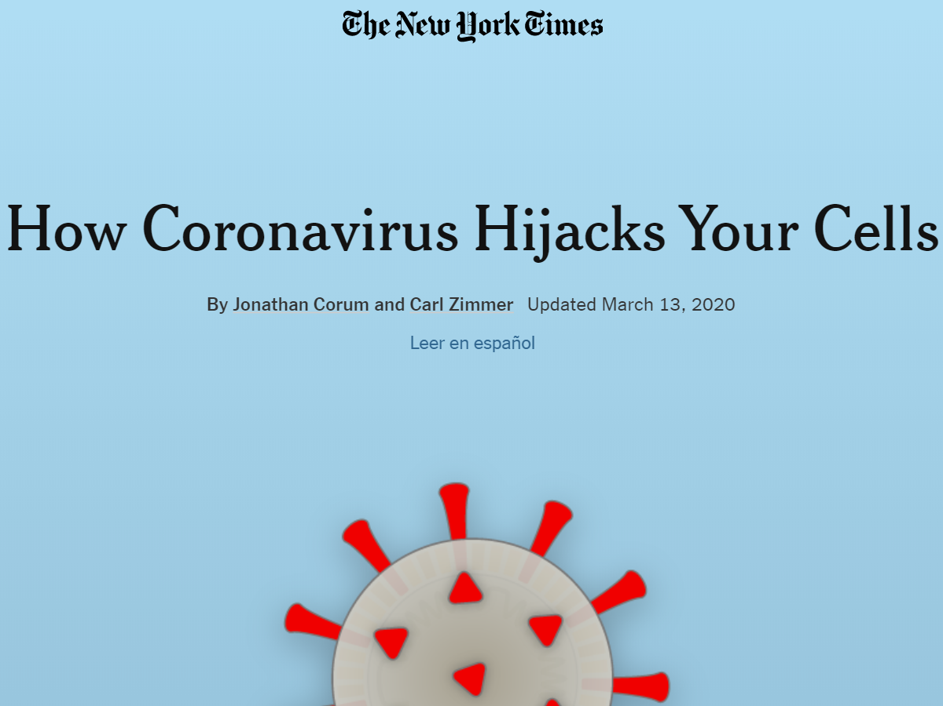

Slide 2
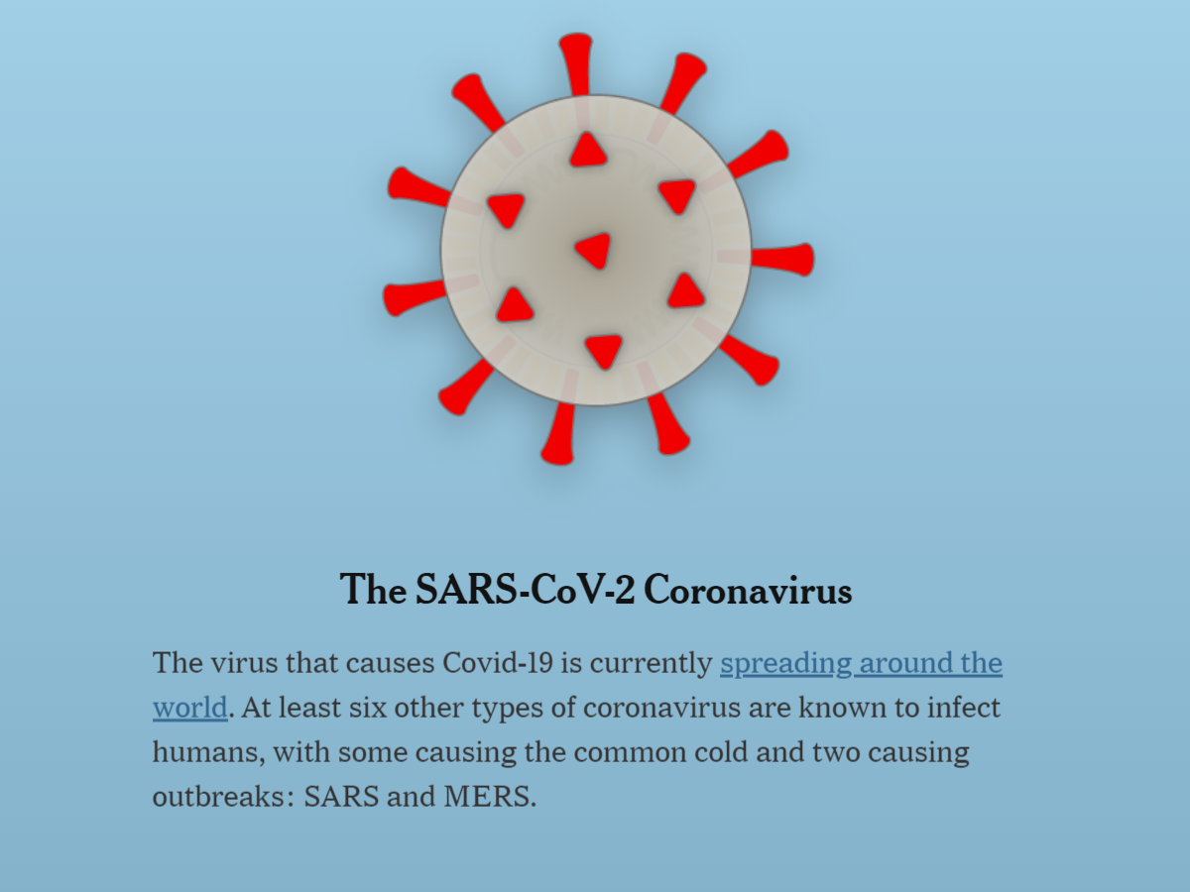

Slide 3
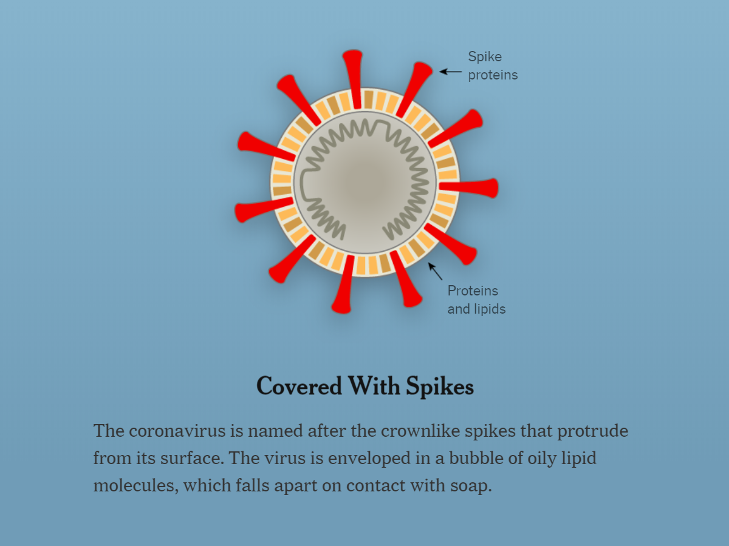

Slide 4
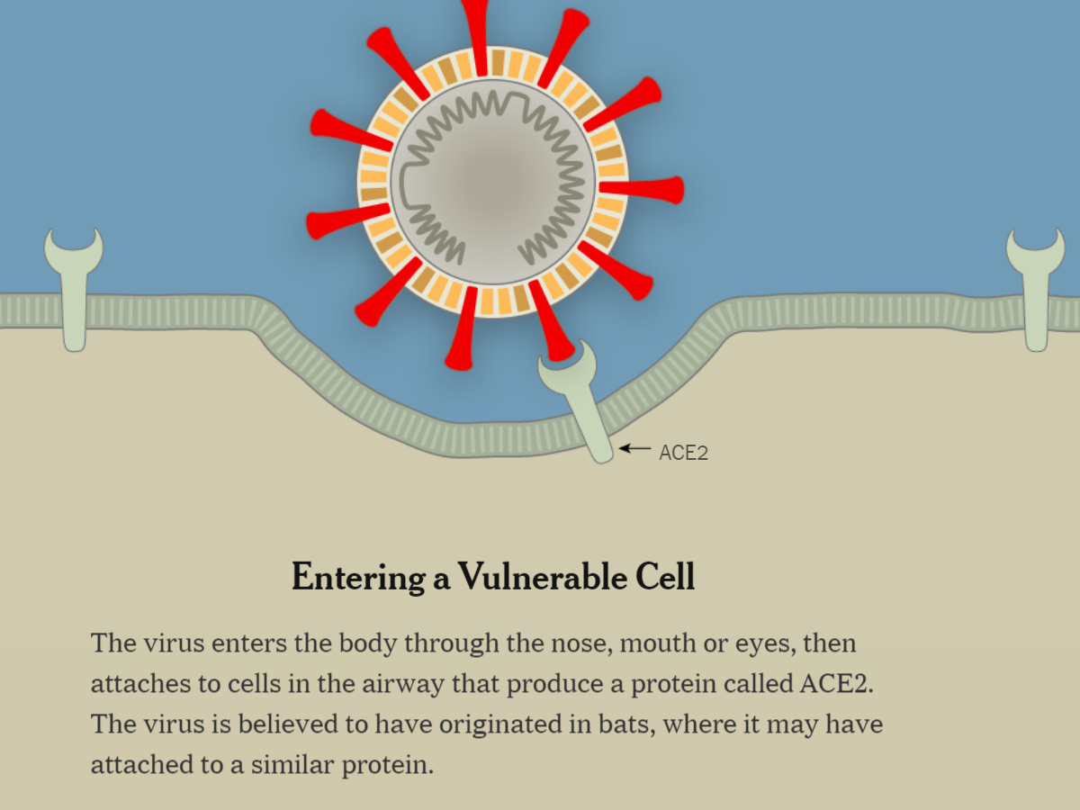

Slide 5
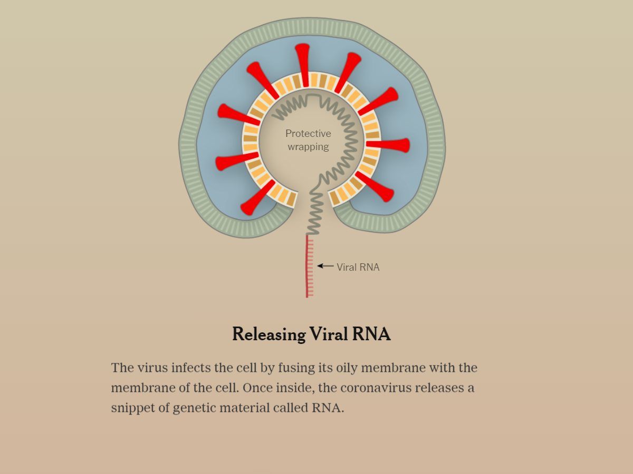

Slide 6
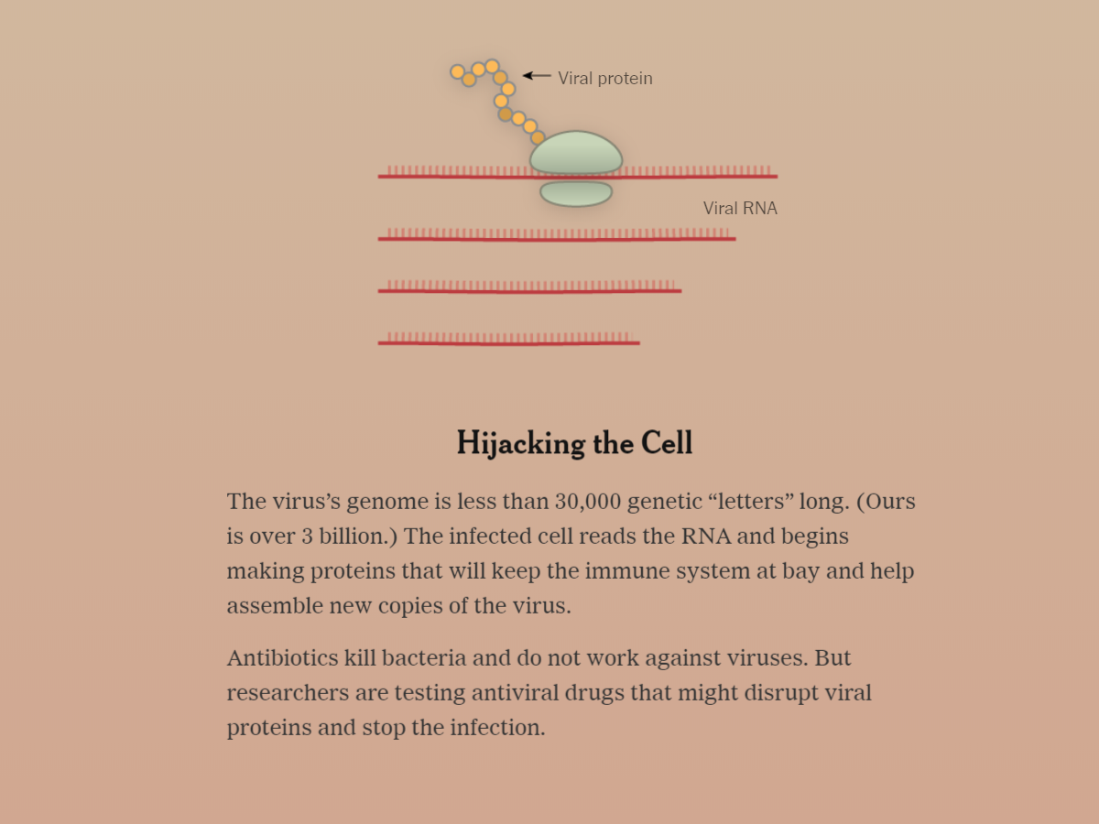

Slide 7
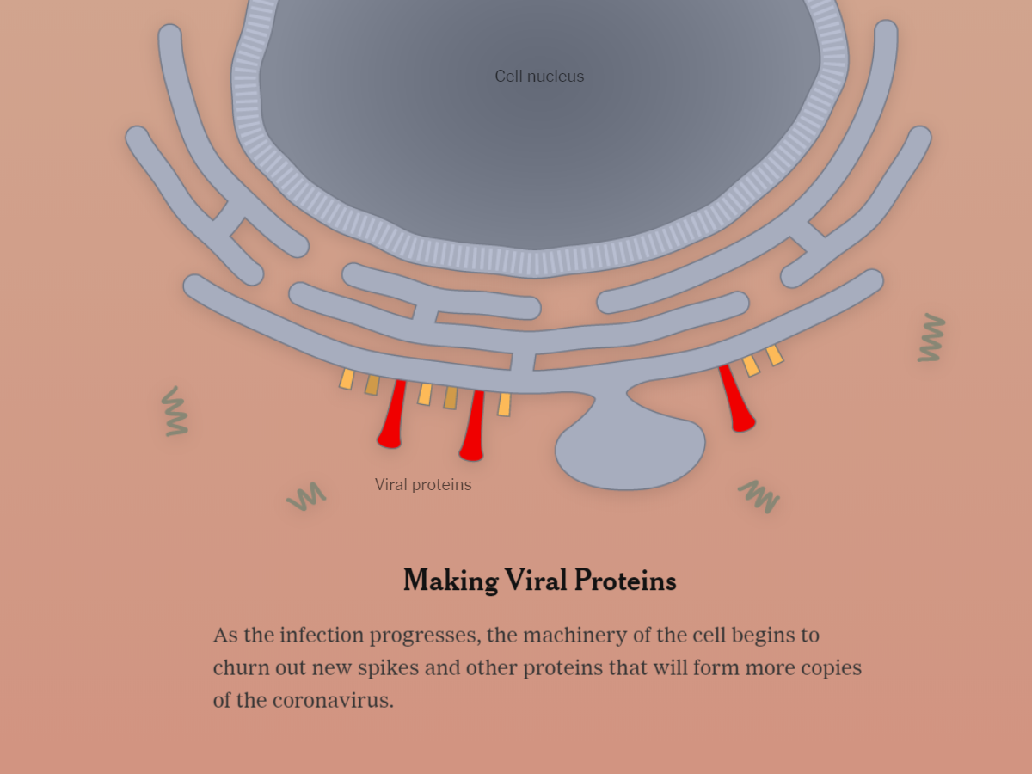

Slide 8
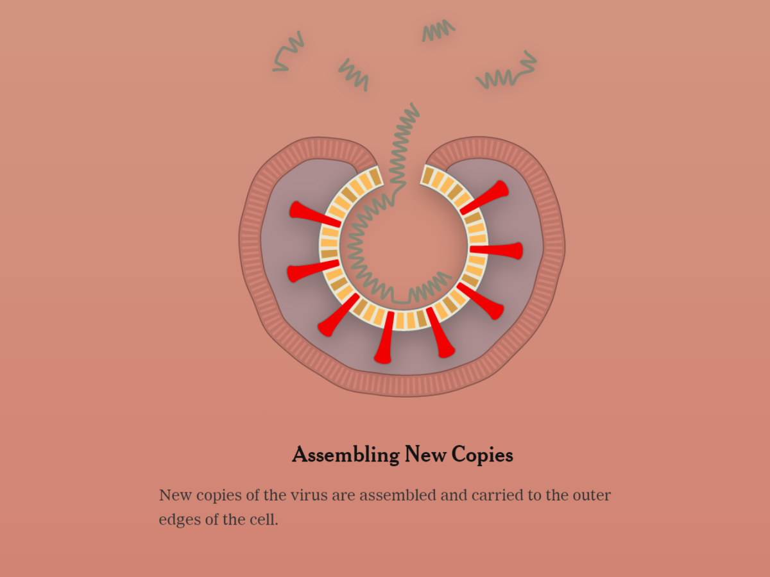

Slide 9
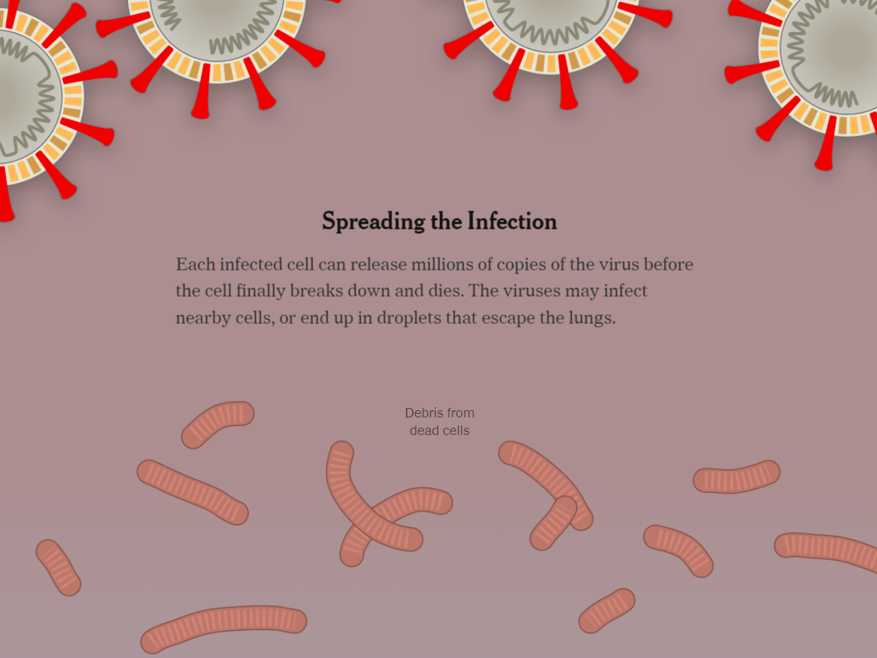

Slide 10
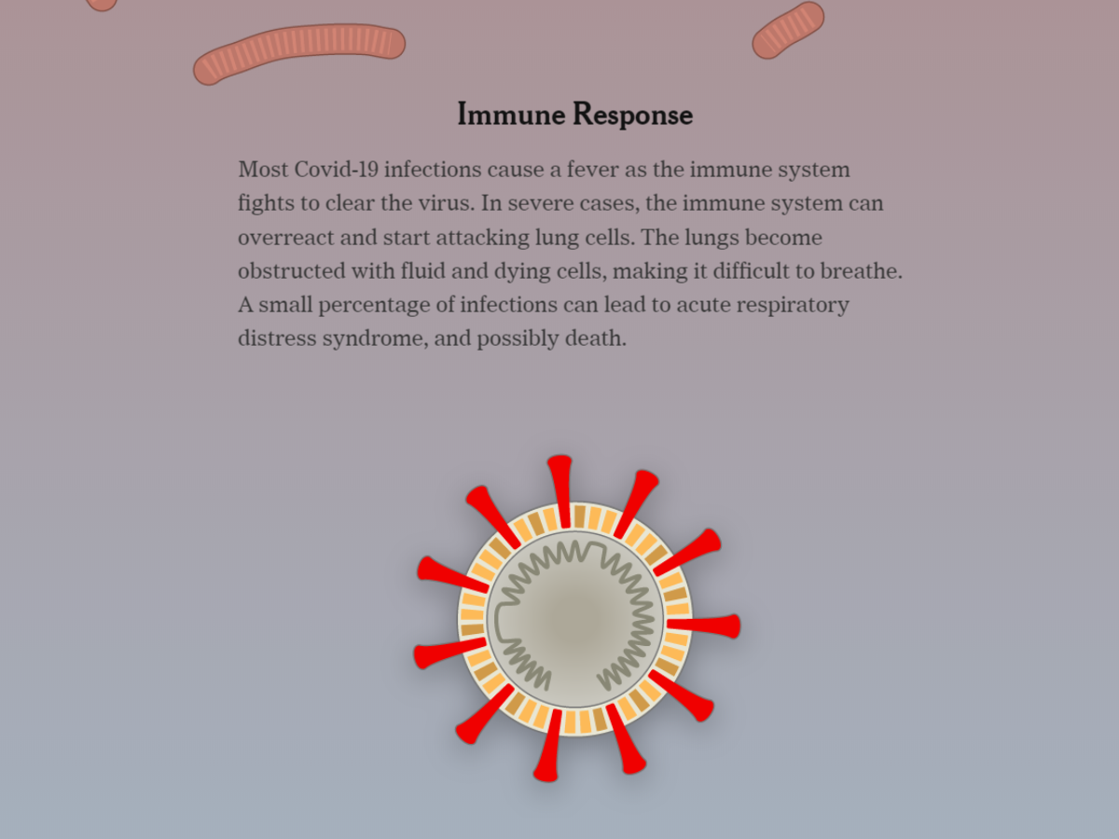

Slide 11
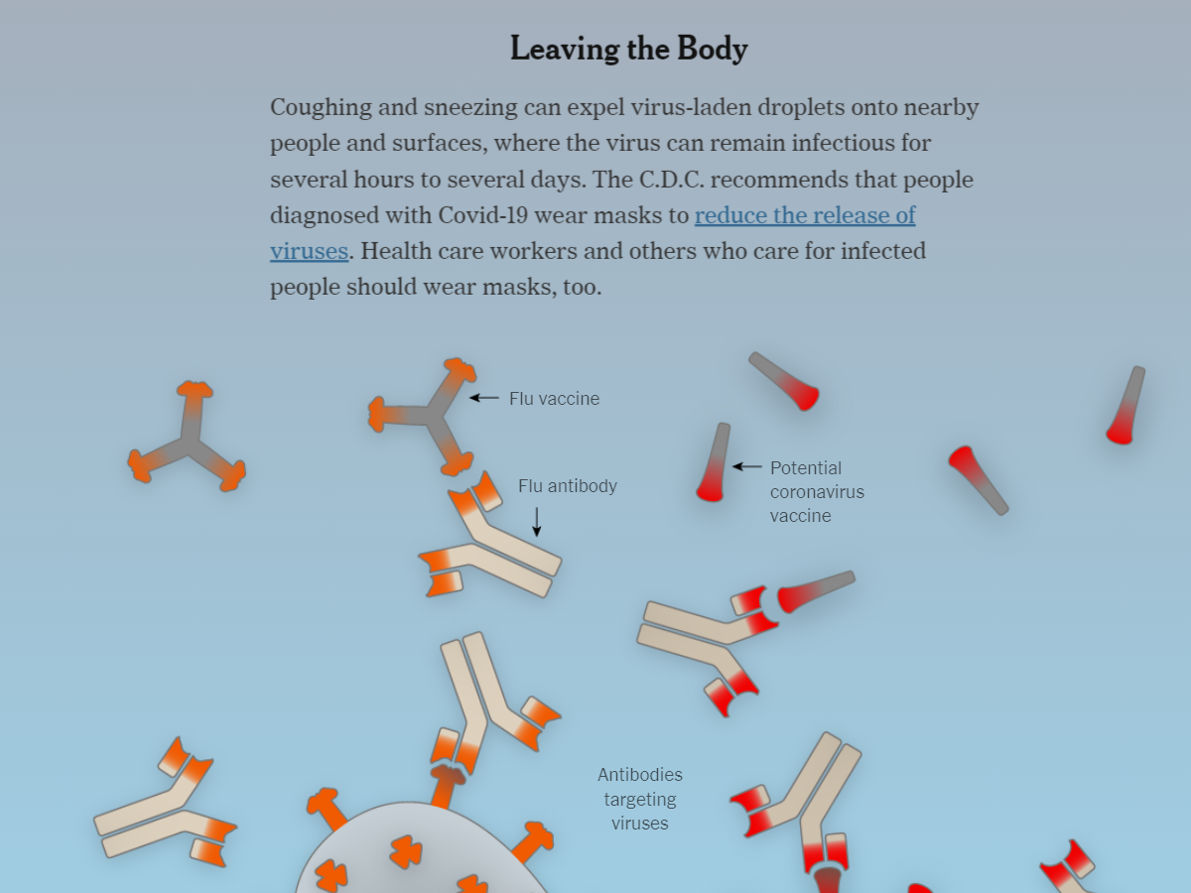

Slide 12
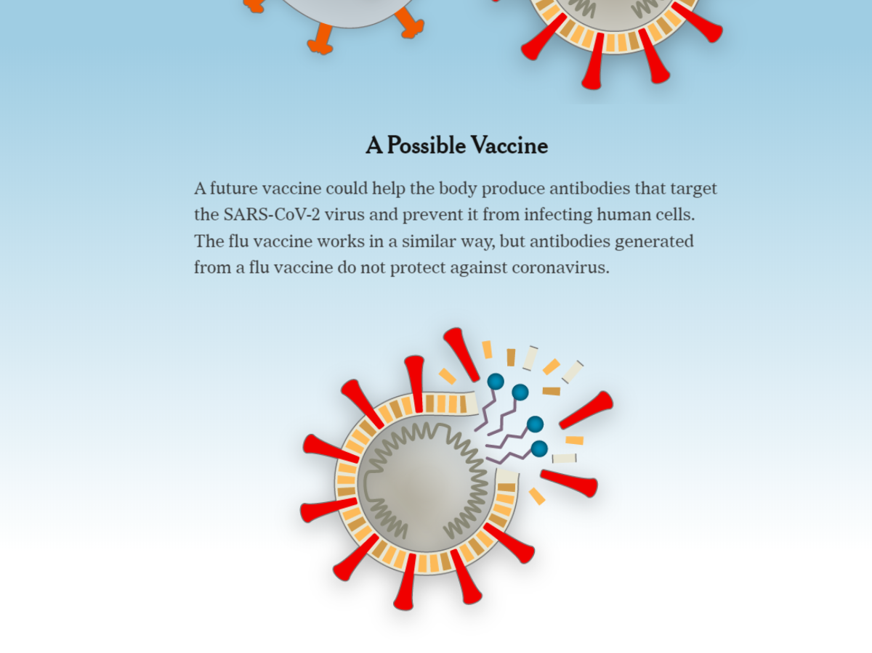

Slide 13
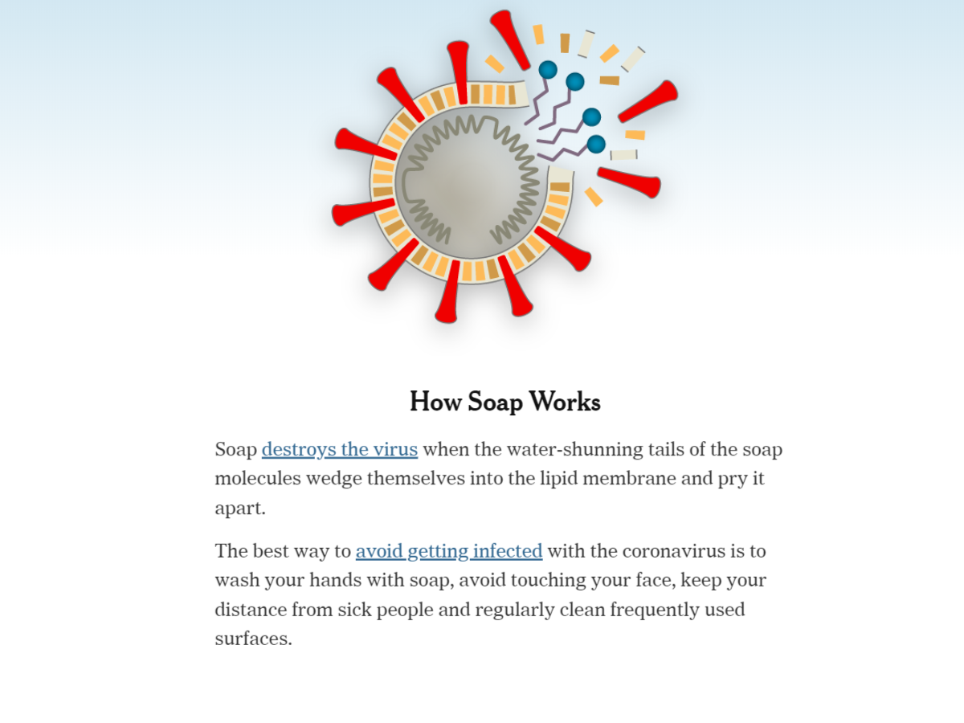

Slide 14
PRINCIPLES of SCRIPTURE
Quarantine Works (1 Corinthians 5:5-6)
  deliver such a one to Satan for the destruction of the flesh, that his spirit may be saved in the day of the Lord Jesus. Your glorying is not good. Do you not know that a little leaven leavens the whole lump?
Hand Washing Goes A Long Way (James 4:8)
  Draw near to God, and he will draw near to you. Cleanse your hands, you sinners, and purify your hearts, you double-minded.

Slide 15
PRINCIPLES of SCRIPTURE
Cleansing Is Necessary (Ephesians 5:25-27)
  Husbands, love your wives, just as Christ also loved the church and gave Himself for her, that He might sanctify and cleanse her with the washing of water by the word, that He might present her to Himself a glorious church, not having spot or wrinkle or any such thing, but that she should be holy and without blemish.
Sometimes The Attempt At Removing Infection Destroys More Than The Disease (Mat. 13:27-29)

Slide 16
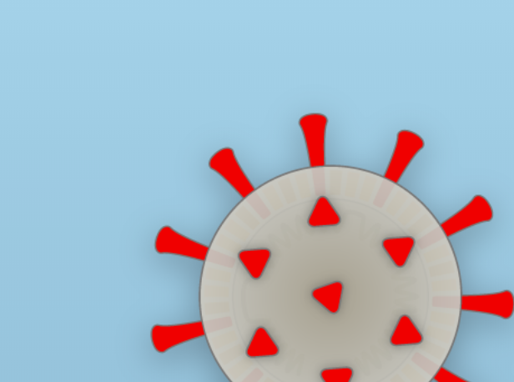
CORONAVIRUS IS NOT THE CONTAGION THAT CHANGED THE WORLD
SIN IS.

Slide 17
THE CONTAGION
SIN – 100% Infection Rate
SIN – is Global
SIN – If Untreated = 100% Death Rate

Slide 18
THE CURE
THE CURE – Must be administered (Col 1:14)
THE CURE – Is LIVING (Col. 1:15-20)
THE CURE – Must Be Maintained In Us
(Col. 1:20-23)
THE CURE – Must Be Passed On to Defeat
the Pandemic (Col. 1:26-29)
THE CURE – Requires Sacrifice from the
Cured Population (Col. 1:24-25)
THE CURE – Has Treatment Centers
(Eph. 3:8-21)

Slide 19
THE CONTAGION
SIN – is overcome by washing.
SIN – is curable.
SIN – the worst contagion in the world, and we do not have enough people SHARING THE CURE.

